Slide 1
Intro to FP4 Inference

Slide 2
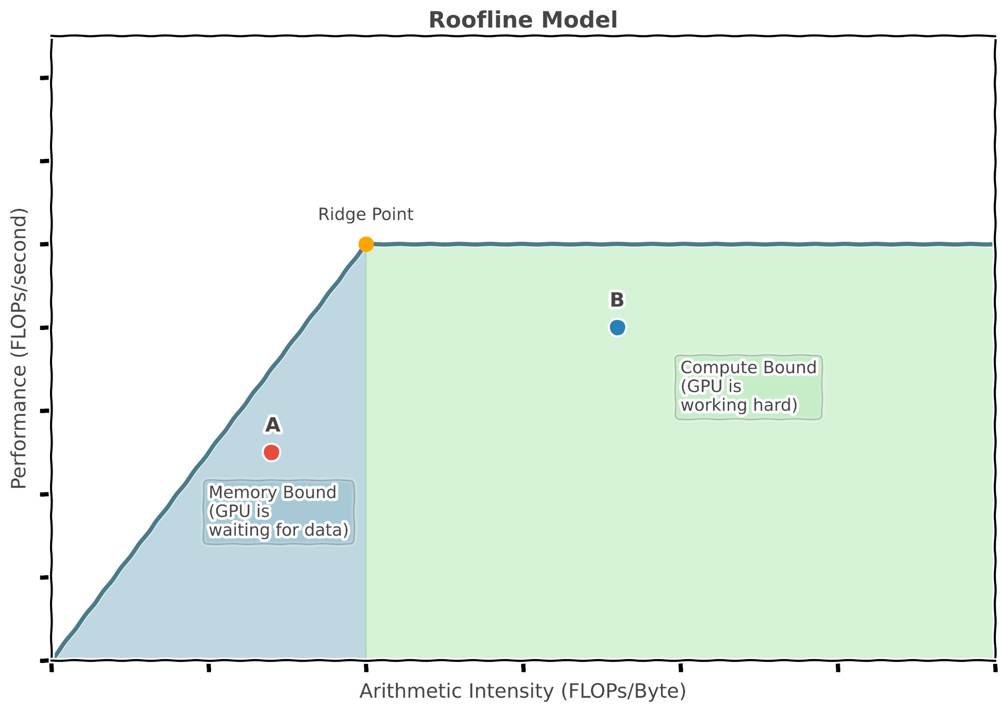
At low batch sizes, inference is memory bound
Specifically, limited by the bandwidth between the GPU VRAM and the local cache of the Streaming Multiprocessors (which execute compute)
Notes:
https://verda.com/blog/multi-head-latent-attention-benefits-in-memory-and-computation

Slide 3
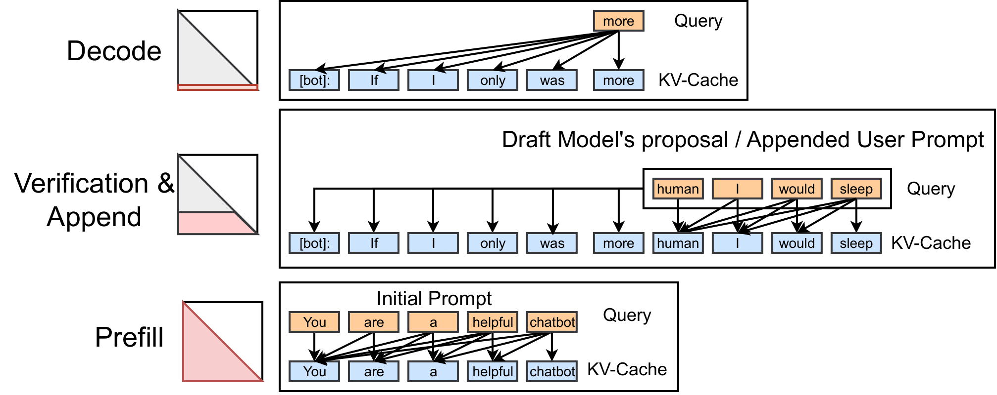
Prefill and decode have separate requirements
Prefill: all query tokens attend to all previous tokens. Decode: a single query token attends to all previous tokens in the KV cache
Notes:
https://flashinfer.ai/2024/02/02/introduce-flashinfer.html

Slide 4
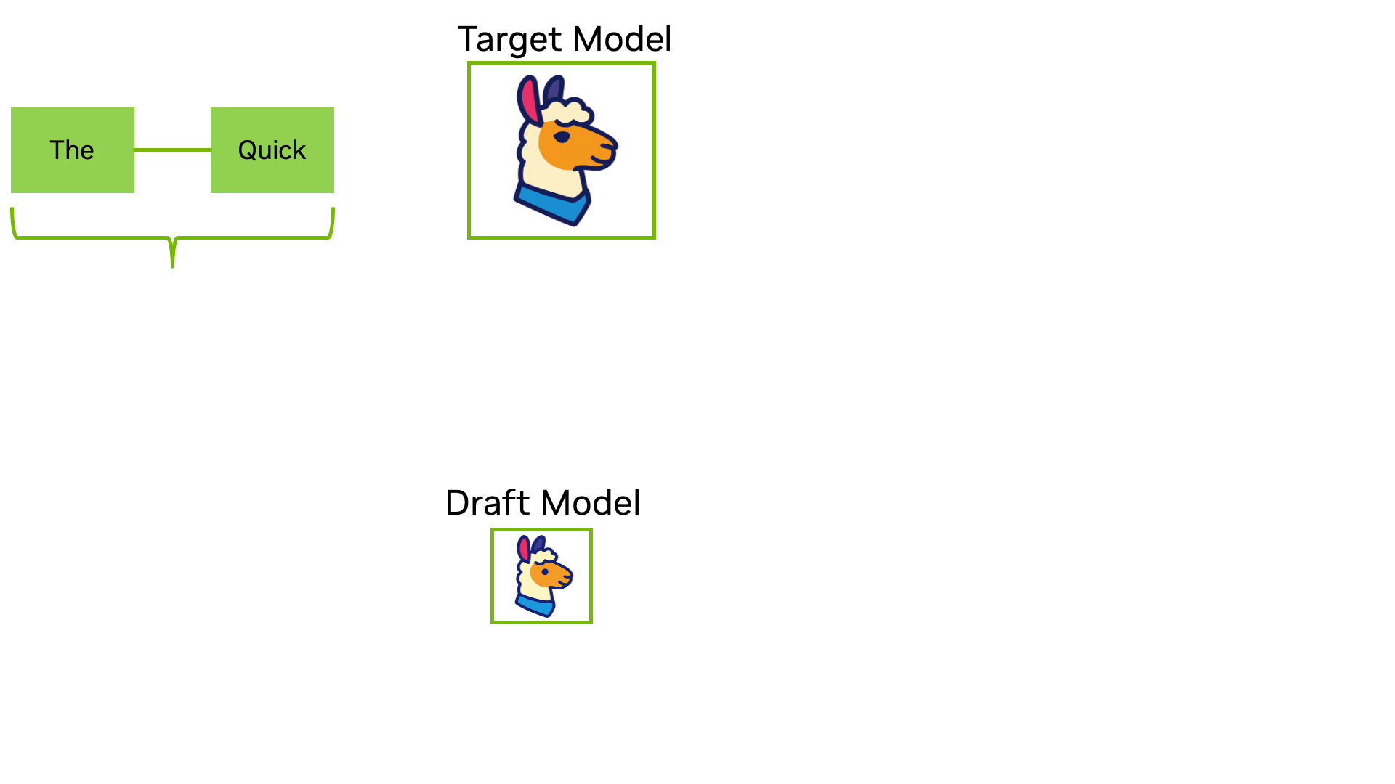
We can do optimizations like:
Speculative decoding
CUDA graphs
Kernel fusion
PD Disaggregation
We are (actively!) working on most of these
Notes:
https://developer.nvidia.com/blog/an-introduction-to-speculative-decoding-for-reducing-latency-in-ai-inference/ https://developer.nvidia.com/blog/constructing-cuda-graphs-with-dynamic-parameters/

Slide 5
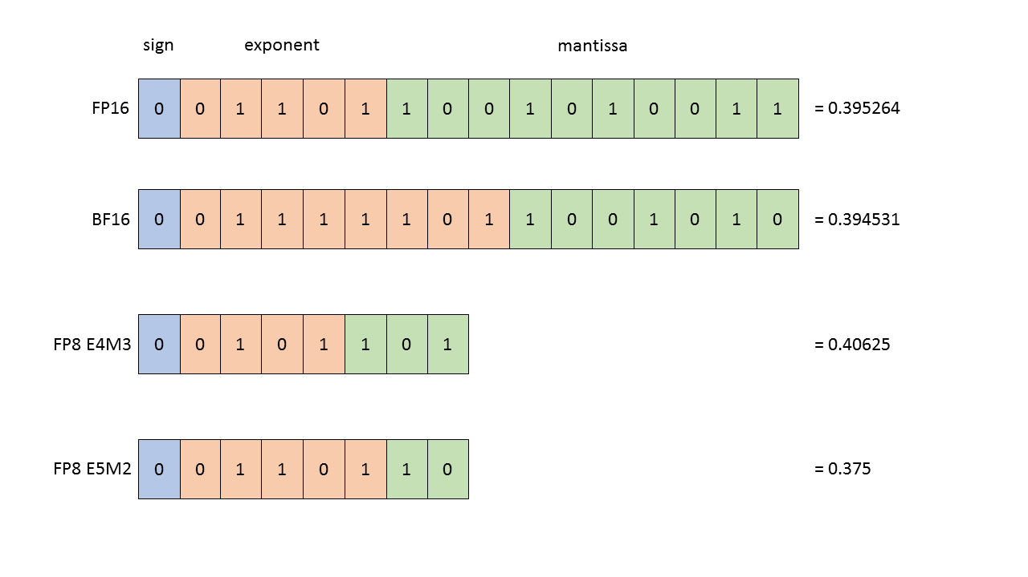
How can quantization help?
FP8 E4M3: value = 2^(exponent - bias) × (1 + mantissa_fraction) → 2^(5-7) × (1 + 0.625) = 0.25 × 1.625 = 0.40625
Use less bits to represent model parameters
Do computation in less bits
Fewer bits means less memory traffic
Can improve both memory and compute bound phases

Slide 6
How can quantization help?
It can benefit both prefill and decode by:
In the prefill phase, it requires less compute
In the decode phase, quantized KV cache reduces the memory being loaded
Notes:
https://flashinfer.ai/2024/02/02/introduce-flashinfer.html

Slide 7
Data type comparisons (no scales)
BF16 (E8M7, 65 536 values, dynamic range = 10^38)
FP8 (E4M3FN, 256 values, dynamic range = 3 x 10^4)
FP4 (E2M1, 15 values, dynamic range = 12)
FN (Finite Numbers). There is no ±∞ encoding (to avoid numerical overflow). It still NaN representation, like BF16
FP4 is finite (no ±∞ and no NaN)
Dynamic range: max finite / min positive value
[-3.4e38, -1e20, -1e6, -1e3, … (+~65,528 values) … , 1e3, 1e6, 1e20, 3.4e38]
[-448, -384, -256, -128, … (+248 values) … , 128, 256, 384, 448]
[-6.0, -4.0, -3.0, -2.0, -1.5, -1.0, -0.5, 0, 0.5, 1.0, 1.5, 2.0, 3.0, 4.0, 6.0]

Slide 8
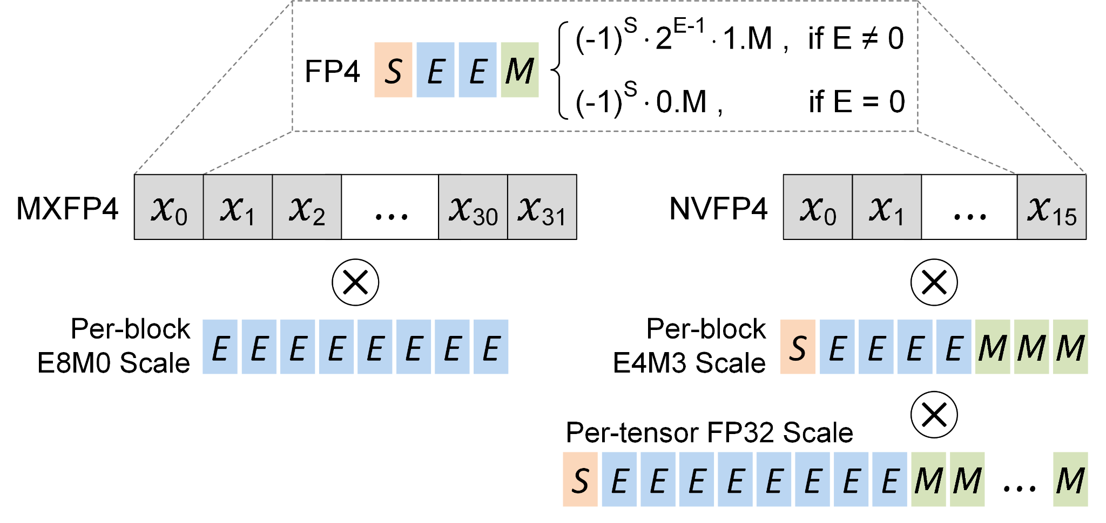
Two types of scaled FP4 representation (MX vs. NV)
Block size: how many elements have a single scaling factor. NVFP4 block size = 16, MXFP4 block size = 32
Per-tensor scale: Each linear layer tensor (e.g Q, K, V projection, feedforward layer), will have 1 FP32 scaling factor
Notes:
https://abdelfattah-lab.github.io/blogs/razer-blog/

Slide 9
Weights vs. Activation Quantization (for NV/MXFP4)
Not all of this holds true for FP8, etc. it depends a lot on the quantization type (also something that can be chosen)
Weights
Quantized offline (during calibration)
FP32 global scale: precomputed, stored in checkpoint
FP8 per-block scales: precomputed, stored in checkpoint
Scales loaded once at model load
Activations
Quantized online (every forward pass)
FP32 global scale: precomputed during calibration, stored in checkpoint
FP8 per-block scales: computed dynamically at inference time (these values are very dynamic per token, so we need to calculate these scales online)

Slide 10
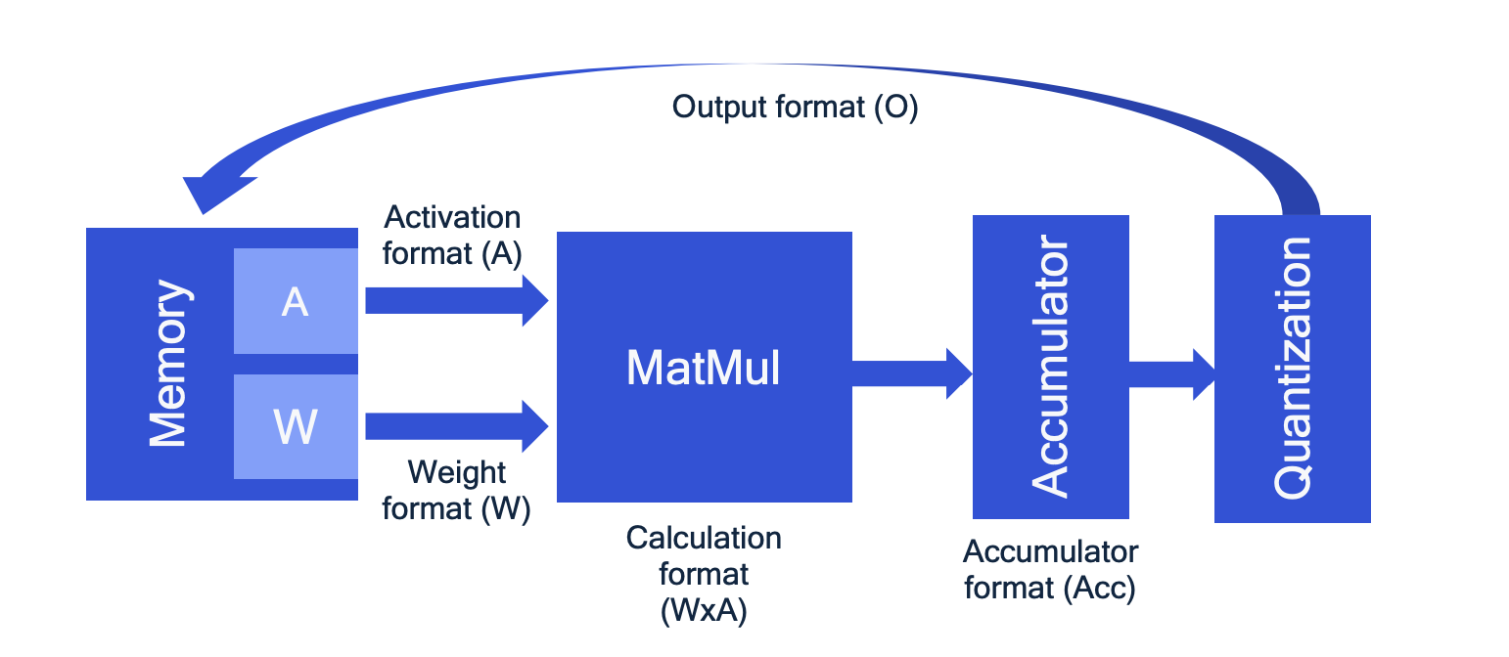
Quantized inference
Accumulator dtype is higher precision (otherwise, too much precision loss)
Notes:
https://abdelfattah-lab.github.io/blogs/razer-blog/

Slide 11
Why the secondary scaling factor?
Finding the block-level scaling factor (represented in FP8): represent the maximal values of the block
Block 0
Block 1
We divide 6, because 6 * per_tensor scaling factor needs to represent the original maximal value
block_max = 1000 → scale = 1000/6 = 166.7 ✓ (fits in FP8)
block_max = 5000 → scale = 5000/6 = 833.3 ❌ (exceeds our FP8 max 448)
Notes:
https://abdelfattah-lab.github.io/blogs/razer-blog/

Slide 12
Why the secondary scaling factor?
Global FP32 scale: weight_scale_2 = 5000 / (6 * 448) = 1.86
Block 0
Block 1
We divide 6, because 6 * per_tensor scaling factor needs to represent the original maximal value
per_block_scale = 1000 / (6 * 1.86) = 89.6 ✓ (fits in FP8)
per_block_scale = 5000 / (6 * 1.86) = 448.0 ✓ (fits in FP8)
Notes:
https://abdelfattah-lab.github.io/blogs/razer-blog/

Slide 13
FP4 differences (MX vs. NV)
Each linear layer (e.g Q, K, V projection, feedforward layer), will have 1 FP32 scaling factor
MXFP4 has better range, but NVFP4 has precision at block scale
Feature | MXFP4 | NVFP4
Block Size (how many elements per SF) | 32 | 16
SF Type | E8M0 | E4M3
Tensor-wide SF | No | Yes
AMD | Yes | No
Nvidia Blackwell | Yes | Yes
Notes:
https://abdelfattah-lab.github.io/blogs/razer-blog/

Slide 14
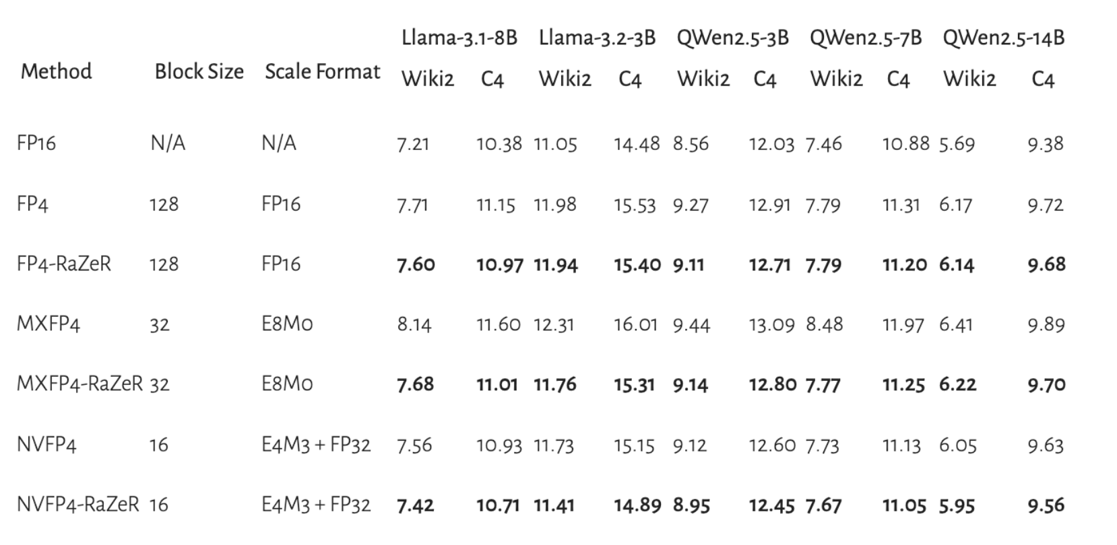
A
Accuracy
A
A
A
Perplexity (heavily simplified): on average, how many equally likely options does the model think there are for the next token
Notes:
https://abdelfattah-lab.github.io/blogs/razer-blog/

Slide 15
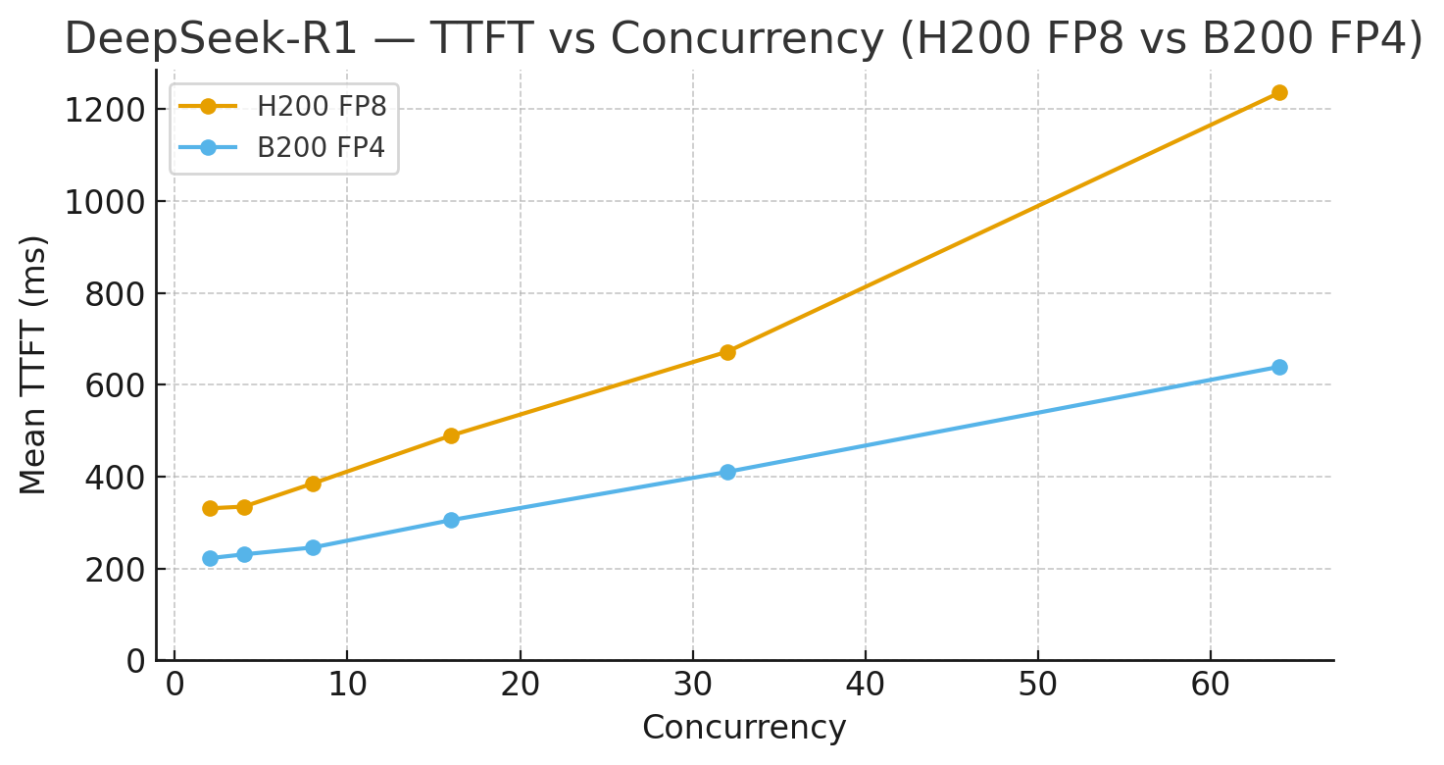
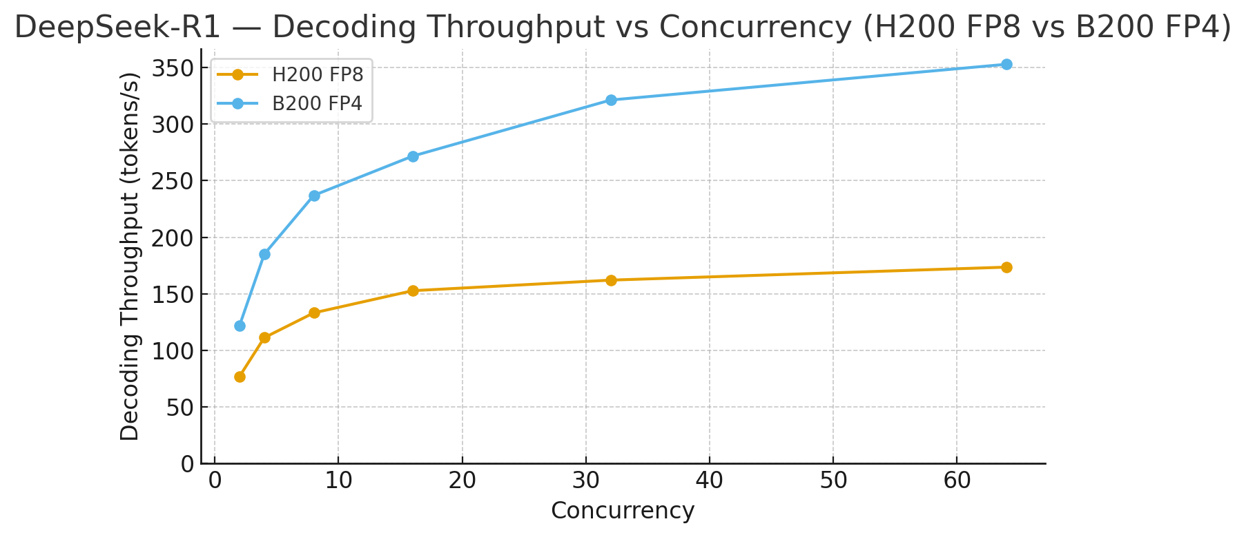
A
Inference Performance
A
A
A
FP4 result can be better, in this checkpoint, Q, K and V projection of Deepseek remained in BF16, while original was in FP8
Notes:
https://abdelfattah-lab.github.io/blogs/razer-blog/

Slide 16
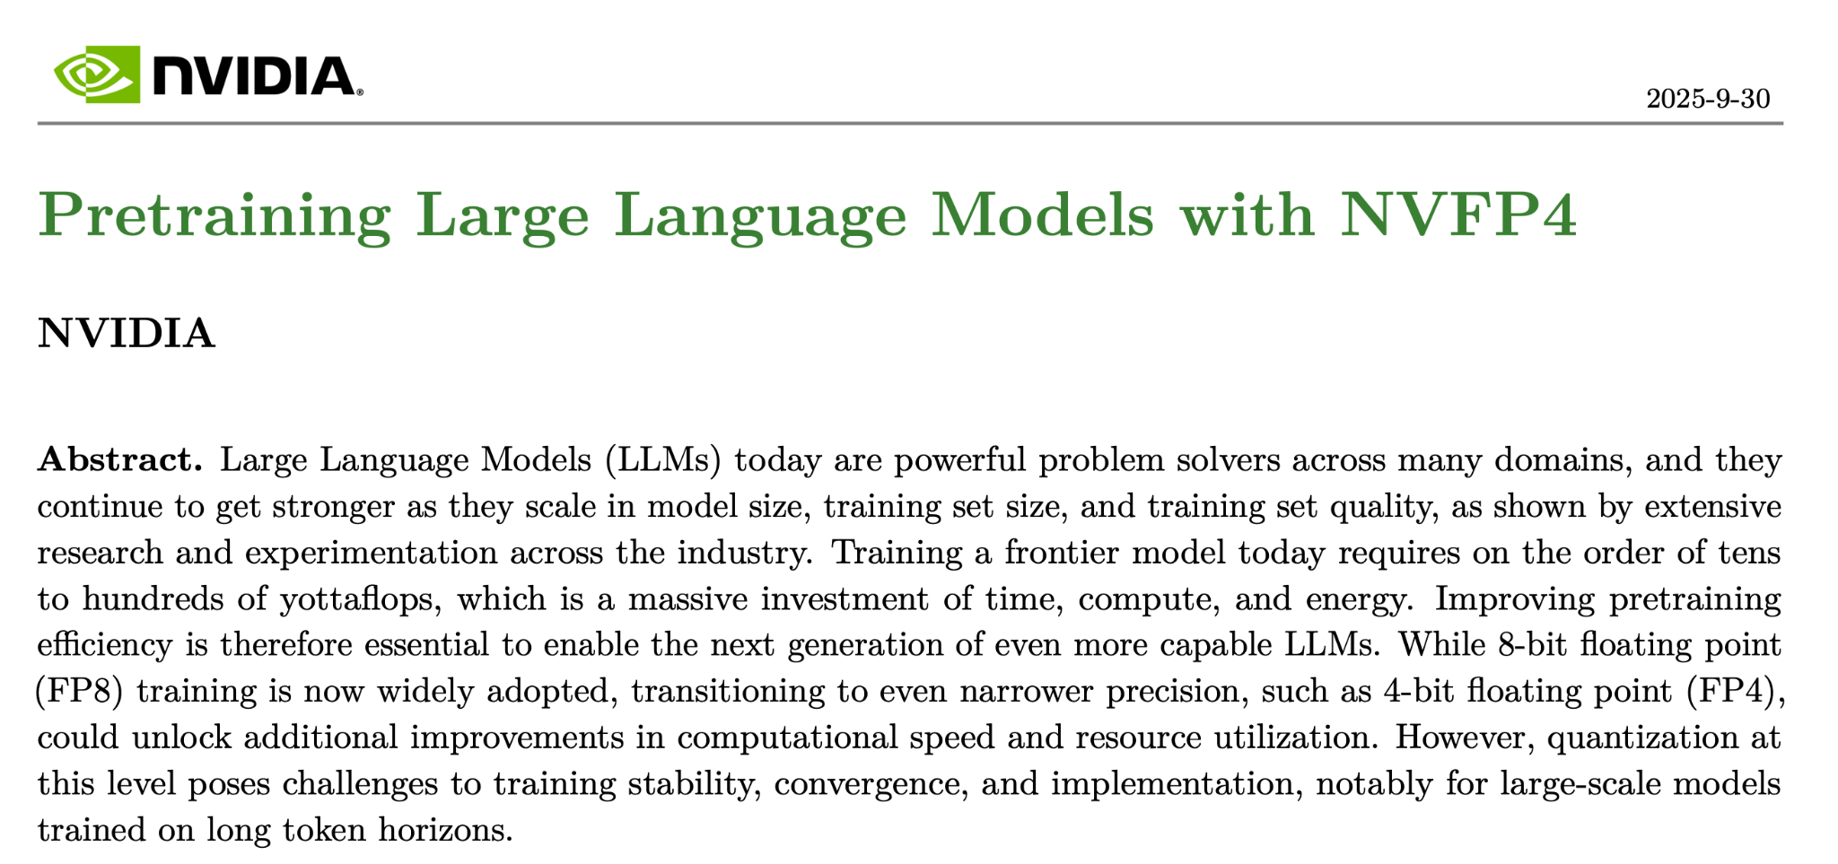
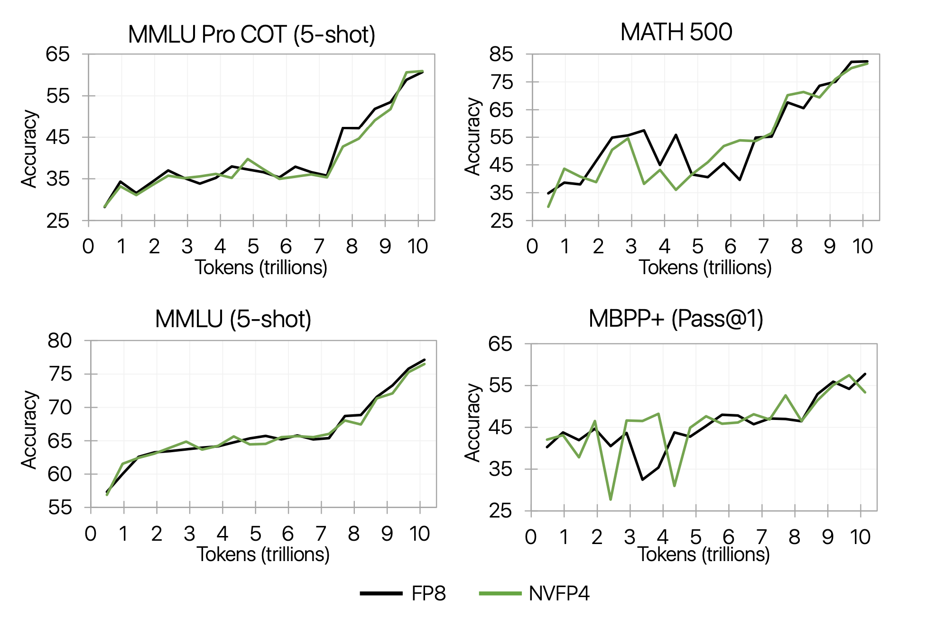
A
Training: can we actually use it beyond PTQ inference?
Nemotron has done pre-training, albeit with many caveats
Notes:
https://arxiv.org/pdf/2509.25149v1

Slide 17
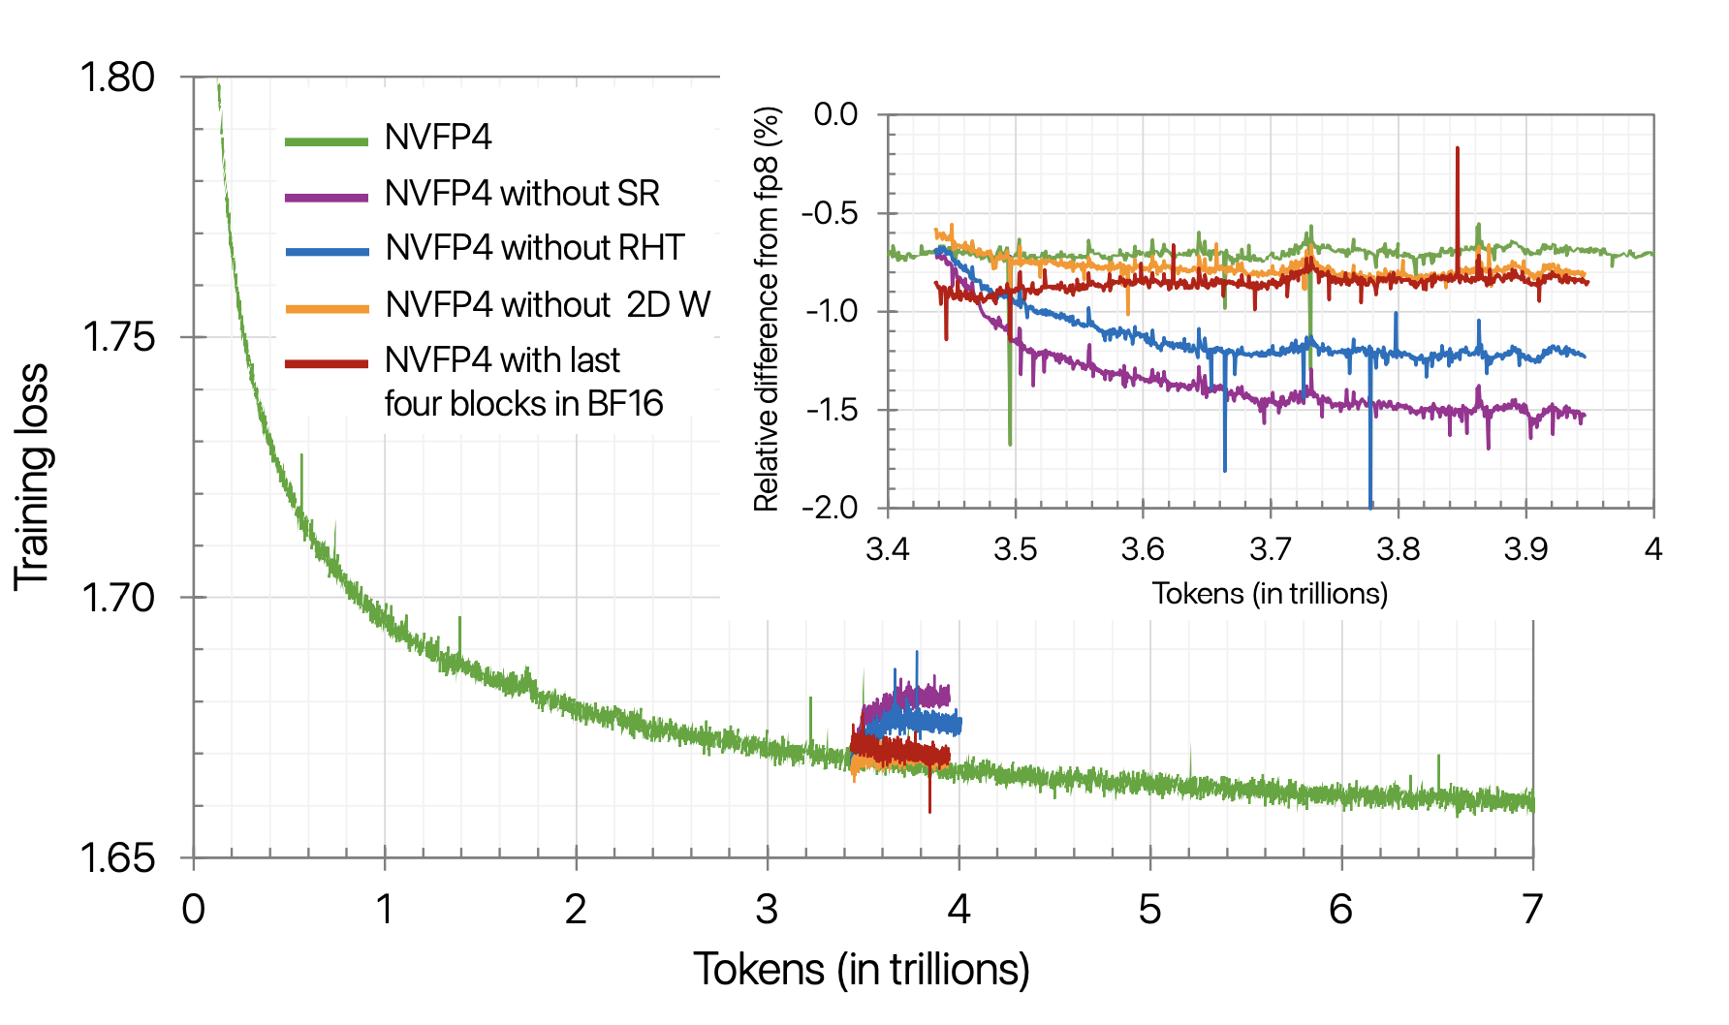
A
Pre-training in NVFP4
Keep 15% of linear layers in BF16 (first 2 and last 8 blocks)
Random Hadmard transform on weight gradients
Round gradients during training in a random way to avoid rounding bias
Use 16 x 16 blocks instead of 1 x 16 blocks
During final 18% of training switch to BF16
Nemotron has done pre-training, albeit with many caveats above:
Notes:
https://arxiv.org/pdf/2509.25149v1

Slide 18
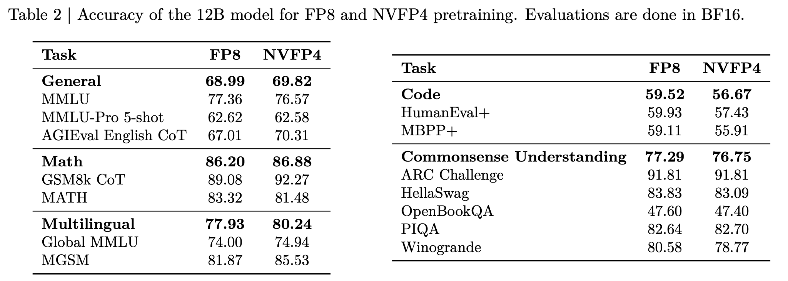
A
Pre-training in NVFP4
Notes:
https://arxiv.org/pdf/2509.25149v1

Slide 19
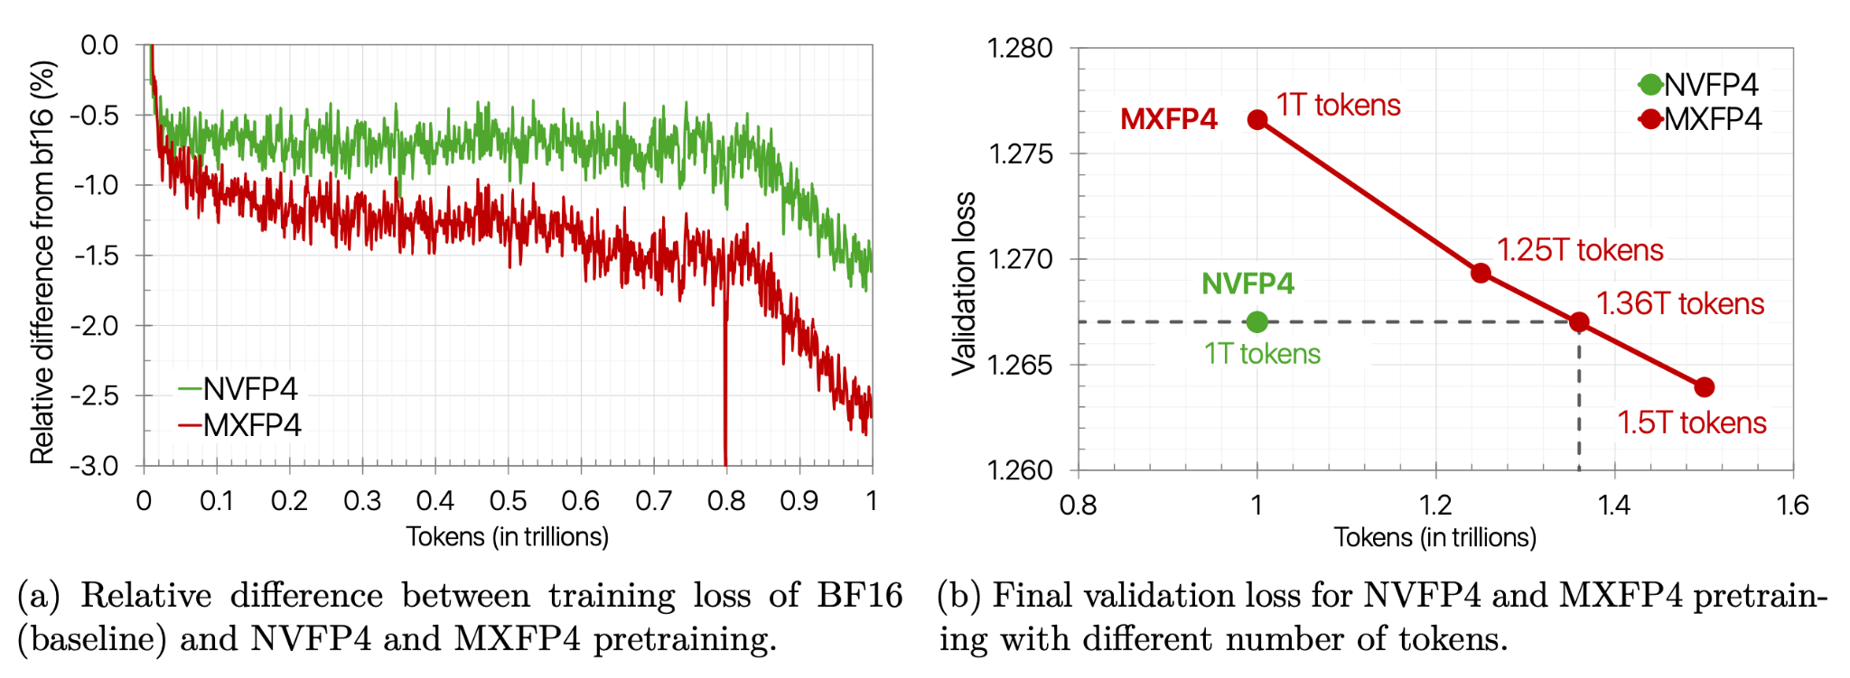
A
Pre-training in NVFP4
Notes:
https://arxiv.org/pdf/2509.25149v1

Slide 20
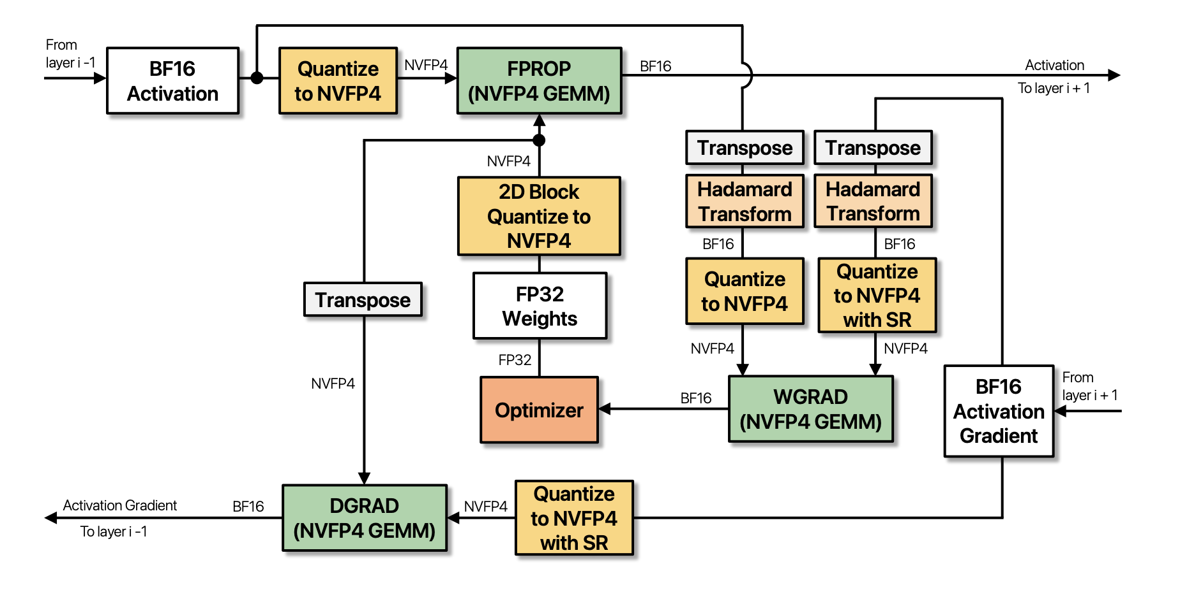
A
Pre-training in NVFP4
Notes:
https://arxiv.org/pdf/2509.25149v1

Slide 21
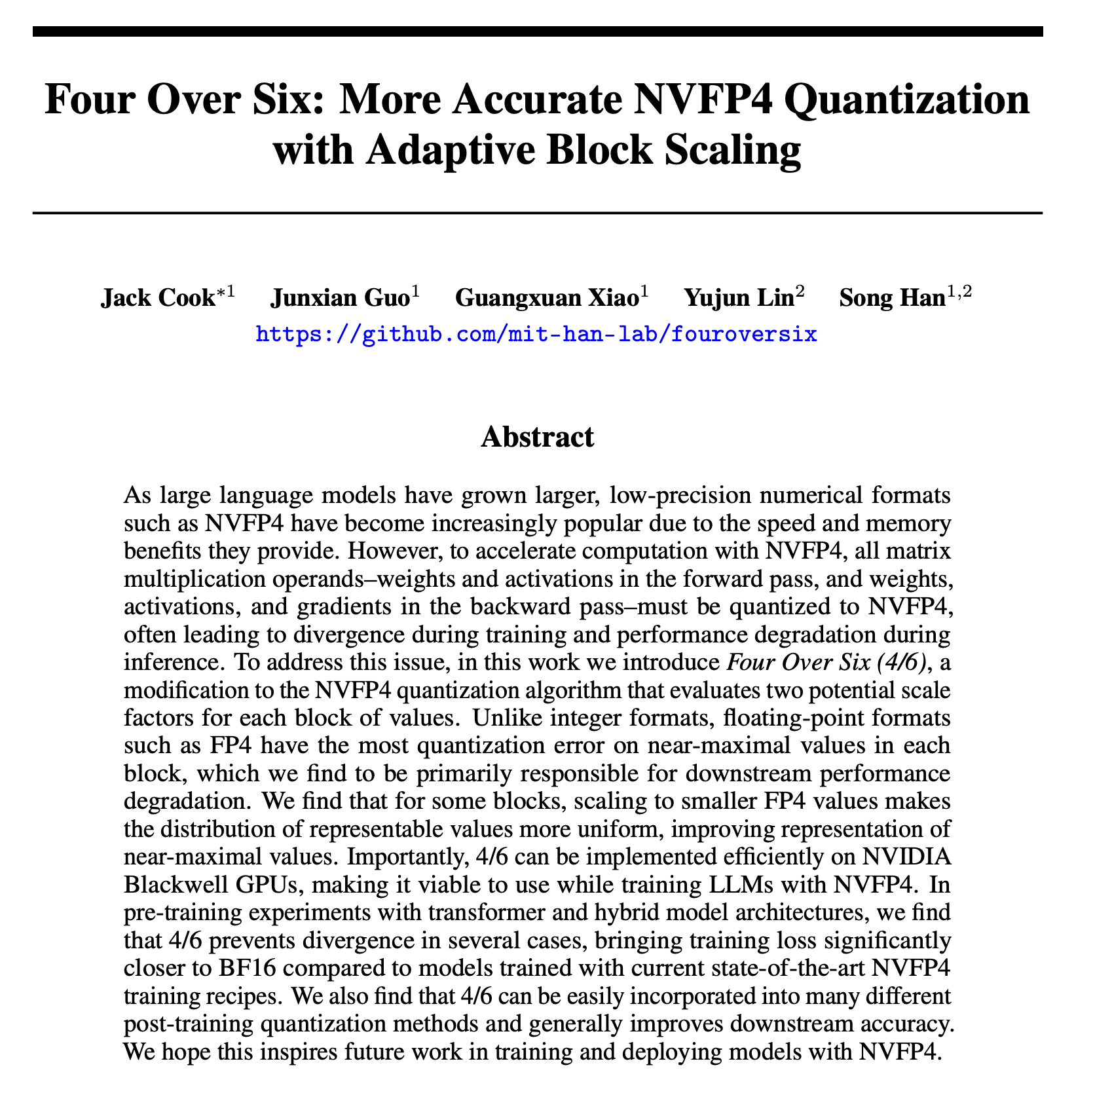
A
Notes:
https://arxiv.org/pdf/2512.02010

Slide 22
Four over Six
Problem with standard NVFP4 (scaling to 6):
Ideal scale factor is (40/6 = 6.67). But FP8 can only represent 6.5
Ideal scale factor is (40/6 = 6.67)
Scale to FP4 representable values:
Error: Can't represent values between 66.6% and 100% of max!
Block values: [10, 20, 30, 40] (max = 40)
Scaled: [1.54, 3.08, 4.62, 6.15]
Block values: [1.5, 3, 4, 6]

Slide 23
Four over Six
NVFP4 with scaling to 4:
Ideal scale factor is (40/4 = 10.0)
Scale to FP4 representable values:
Can represent all values with 0% relative error
Block values: [10, 20, 30, 40] (max = 40)
Scaled: [1.0, 2.0, 3.0, 4.0]
Block values: [1, 2, 3, 4]

Slide 24
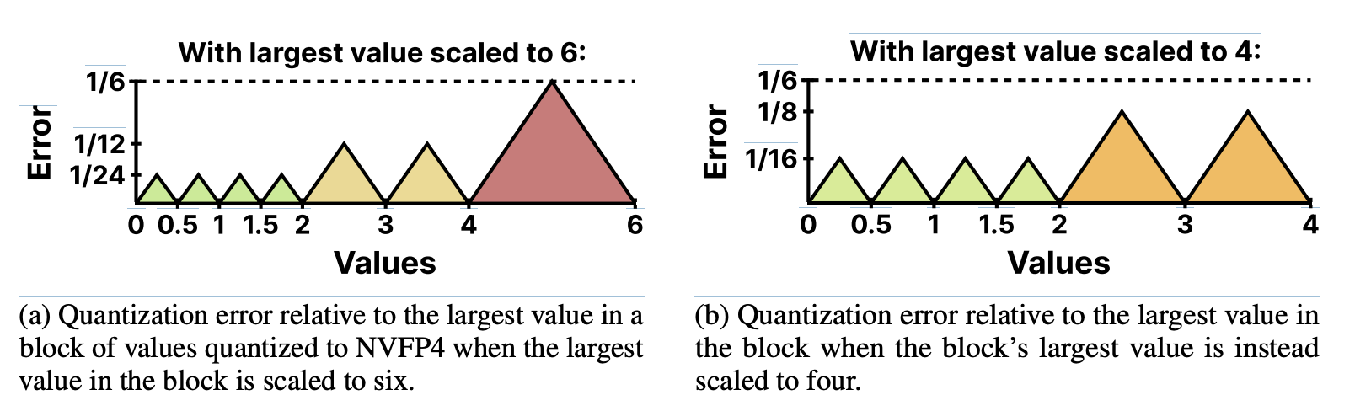
Scaling to 4 can better represent outlier values
Fundamentally, floating point has a better outlier handling than integer formats due to non uniform step sizes

Slide 25
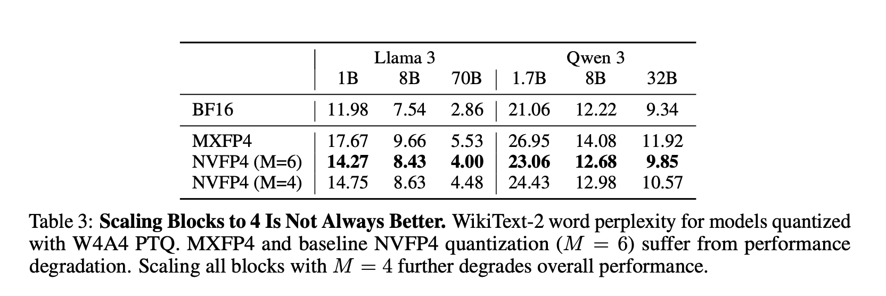
Scaling to 4 is not always better
The error for values closer to the mean (0-2) has increased by a relative 50%, which can explain this result.

Slide 26
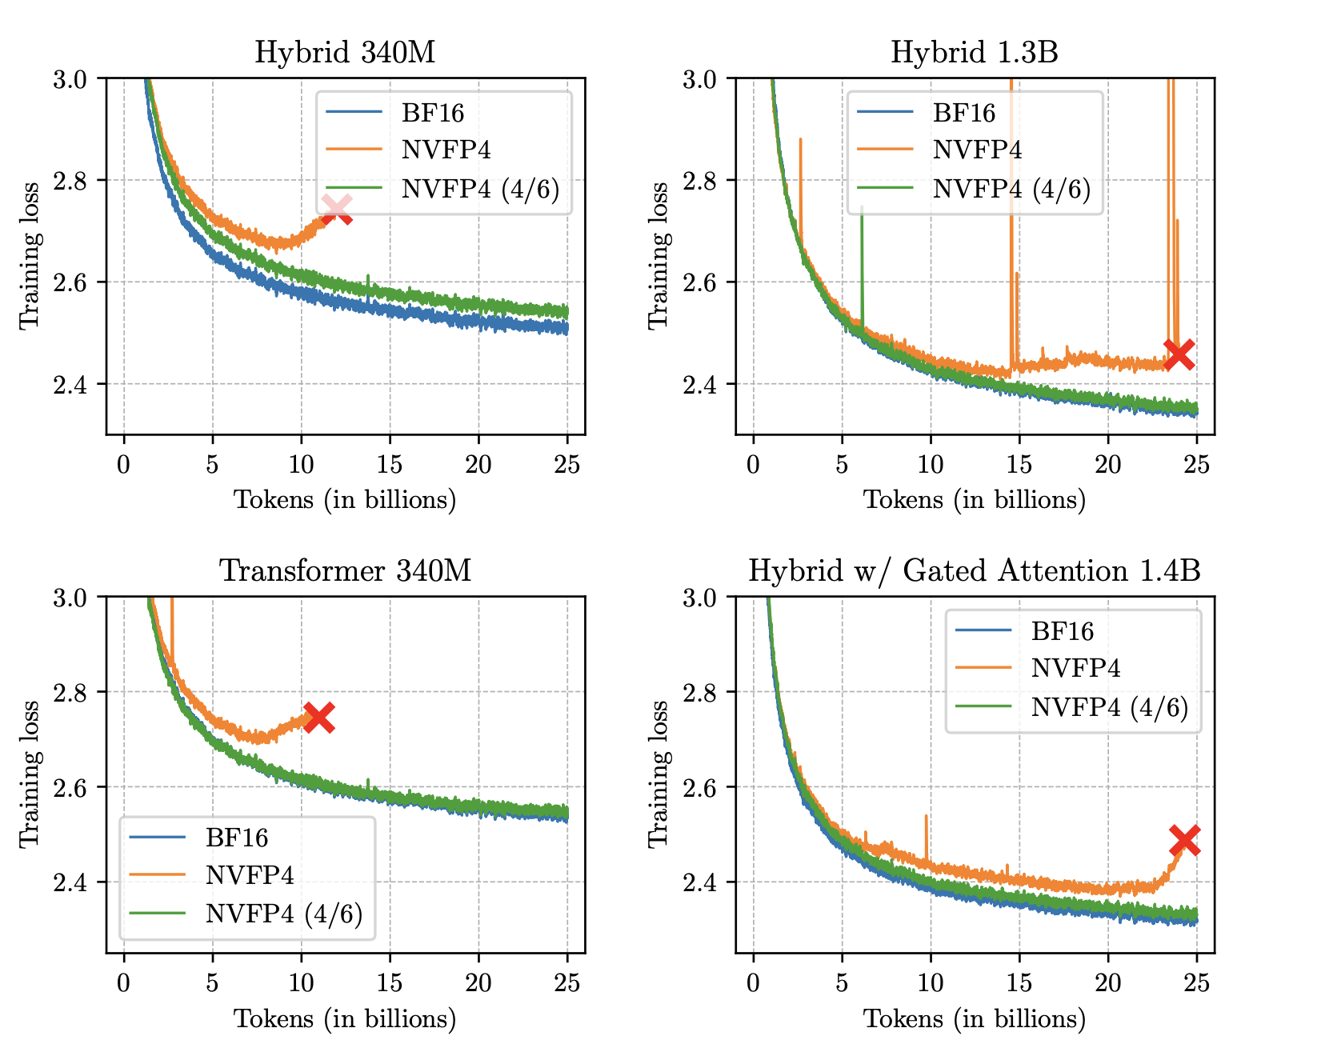
NVFP4 Pre-training with 4/6

